Slide 1



Laptop Site
-Where customer meets satisfaction

Slide 2


Catalogue
Introduction
Description
Additional Features

Slide 3
Introduction
Overview:
This project is an initiative to help and ease the shopping experience of a user at a student level.
This project consists of a thoughtful arsenal of features that makes this project diverse from the other ones.
Purpose:
To develop a feature rich E-commerce site (laptop-site) that focuses on a user comfort alongside multiple operational functionalities for shopping laptops.
Scope:
1. To provide a User the authority to sign up and login for purchase of products.
2. Landing page to brief a user about the site(brands we serve, latest laptops etc.).
3. Details of each product for thorough analysis of it before purchase.
4. Cart page to summarise the total shopping of a user and final payment.

Slide 4
Description
We have classified the project in 5 different parts:
1. Landing Page
2. Signup/Login Page
3. Products Page
4. Product Details Page
5. Product Compare Page
6. Cart Page

Slide 5
Additional Features Provided
1. Cart Page
- A user facility to add/remove one or multiple products and in the cart page and also buy them.
2. Compare Page
- The user can get a clearer view of which product to buy after comparing 2 products simultaneously.
3. Search product facility
- Users can search for a product by typing a few specific keywords and the results will be fetched.
4. Persistent User Sessions
- User sessions are persistent across the browser even if you close it.
5. Phone number & Mail Address
- Users can contact the site owners or can mail them in case of specific queries.

Slide 6
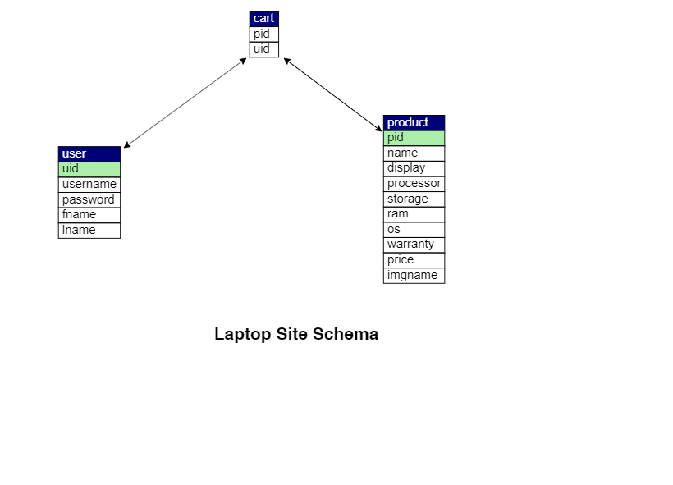
Database Schema:
A design of our MySQL database to clearly understand the relationship between them.

Slide 7

Thank You!
A PROJECT BY:
17101b0021
17101B0022
17101B0023

